Slide 1

Ultrasonic navigation system for blind people
10-04-2021
Name → dhurat Jaydeep dinesh
Roll no → 12
Semester → VI
Department → Computer Science
Academic Year → 2020-21

Slide 2


introduction
This project is built to aid the blind so that they may walk easily in urban areas and avoid obstacles using special detection sensors . This system uses single board computer with microprocessor to alert the concerned. The system is fitted with an ultrasonic sensor. The system alerts the blind person of walking route and also alerts others about the blind person at night through led fitted with it.
The ultrasonic sensors fitted with the system provides obstacle data to the blind person through alert message so that he or she may avoid them. The circuit coupled with LED to let other people and vehicles aware about the blind person in the dark. This single board computer does all the work of detecting ultrasonic signals and sending back respective messages to the blind person.Thus the system provides complete guidance and protection to a blind person under various circumstances.

Slide 3

Software and hardware requirements
Raspberry-Pi (System On Chip)
PCB Board
Vibrating Motor
Motor Driver
LED Indicators (Optional)
Earphones
Ultrasonic Sensor
Jumper Cables
Small Battery (9-10 V)
Switch
Handy or Wearable Material
Python Programming Language
Mu python ide
Thonny python editor
Open source Fritzing CAD software to design circuit

Slide 4

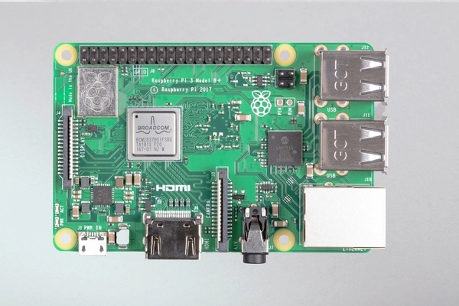
Components used…
The Raspberry Pi 3 Model B+ consists of,
Broadcom pocessor BCM2837B0, Cortex-A53 (ARMv8) 64-bit SoC @ 1.4GHz
1GB RAM
2.4GHz and 5GHz IEEE 802.11.b/g/n/ac wireless LAN and Bluetooth 4.2, BLE
Gigabit Ethernet over USB 2.0 (maximum throughput 300 Mbps)
Extended 40-pin GPIO header (General Purpose Input Output)
Full-size HDMI
4 USB 2.0 ports
CSI camera port for connecting a Raspberry-Pi camera
DSI display port for connecting a Raspberry-Pi touchscreen display
4-pole stereo output and composite video port
Micro SD port for loading your operating system and storing data
5V/2.5A DC power input
Power-over-Ethernet (PoE) support (requires separate PoE HAT)
Raspberry-Pi 3 Model B +

Slide 5
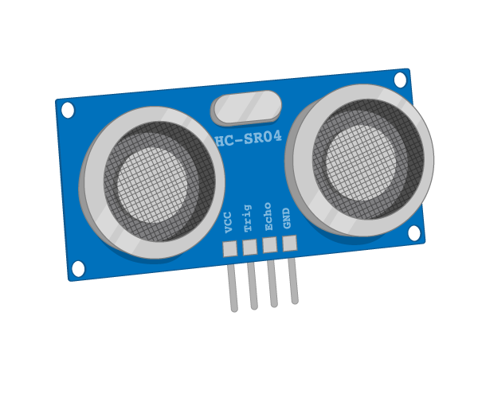
Components used…
The ultrasonic sensor consists of,
VCC Pin
Trigger Pin
Echo Pin
Ground Pin
Ultrasonic Sensor

Slide 6
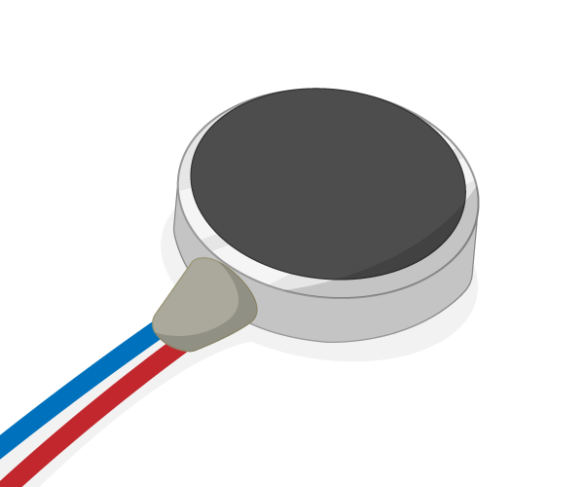
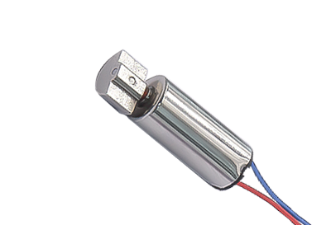
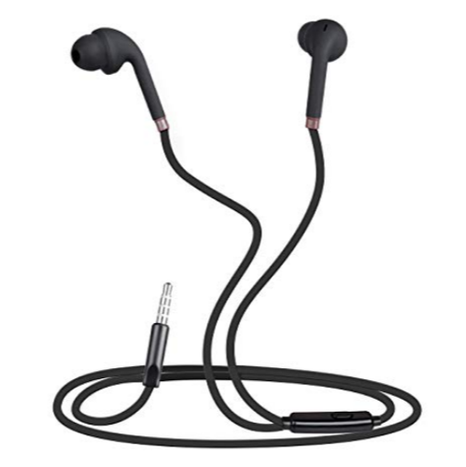
Components used…
The vibration motor consists of,
Positive End (+ve)
Negative End (-ve)
The wired earphones has one audio jack and two speakers which will help individual to give alert.
Vibration Motor
Wired Earphones

Slide 7
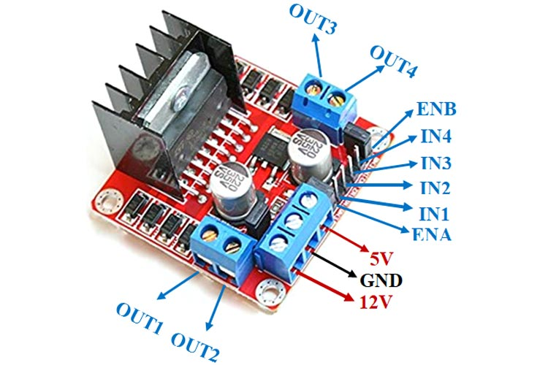
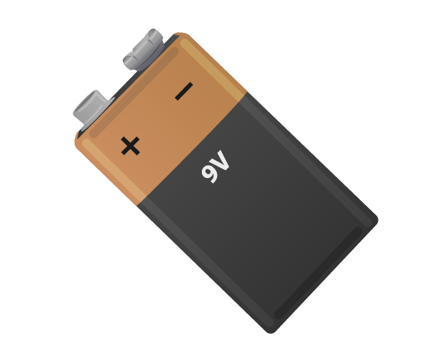
Components used…
The L298N motor driver module consists of,
ENB (Pulse-Width Modulation For Motor)
IN4
IN3
IN2
IN1
ENA
4 Output Ports (i.e OUT1, OUT2, OUT3, OUT4)
5V PIN
GND PIN
12V PIN
Battery to power up the system.
L298N Motor Driver Module
Battery

Slide 8
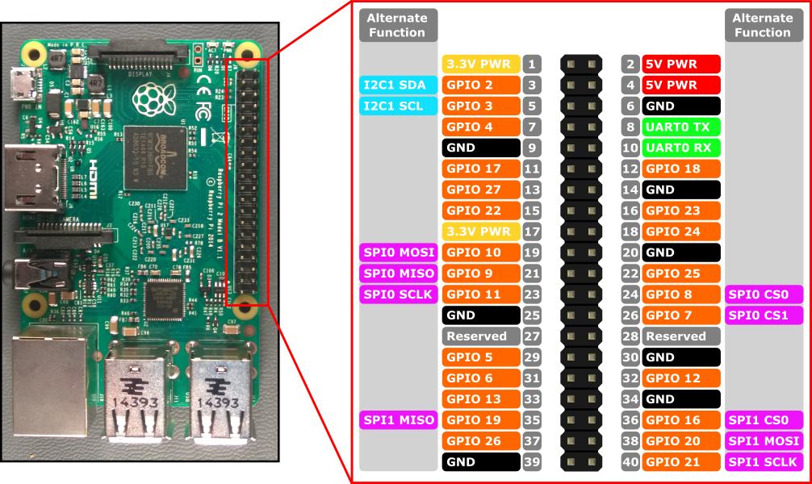
CONNECTIONS
Detail description of GPIO pins of raspberry-pi

Slide 9
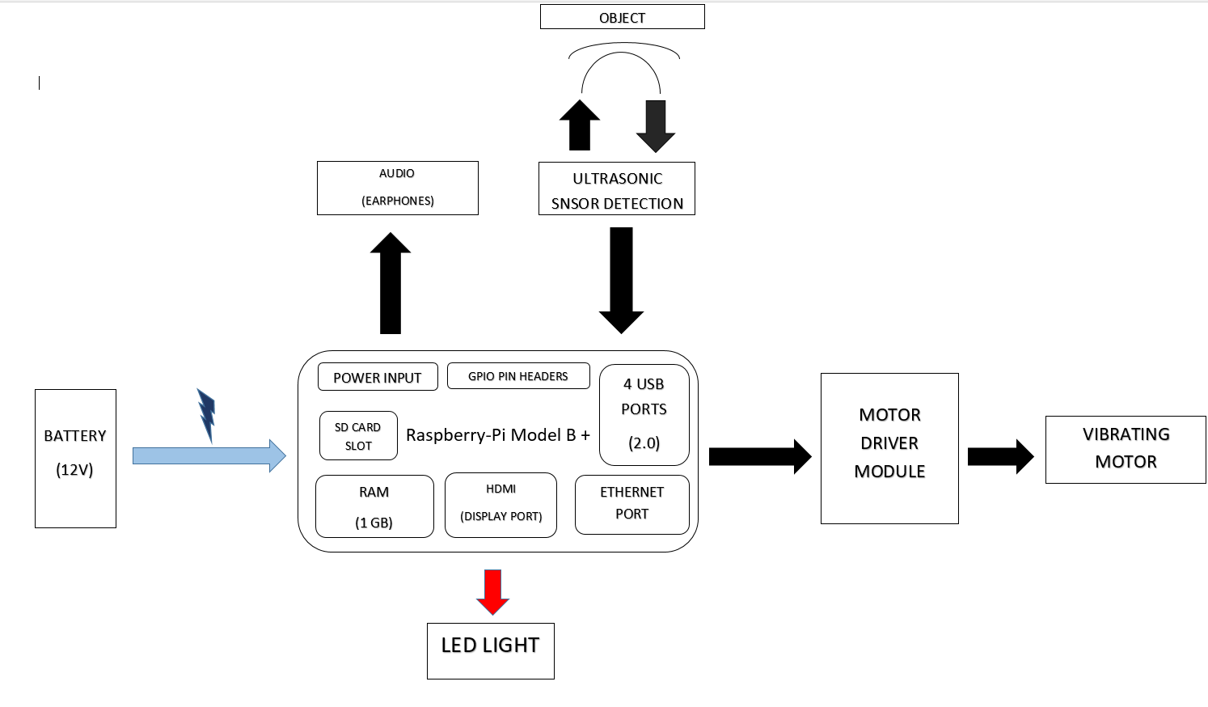
Block diagram of system

Slide 10
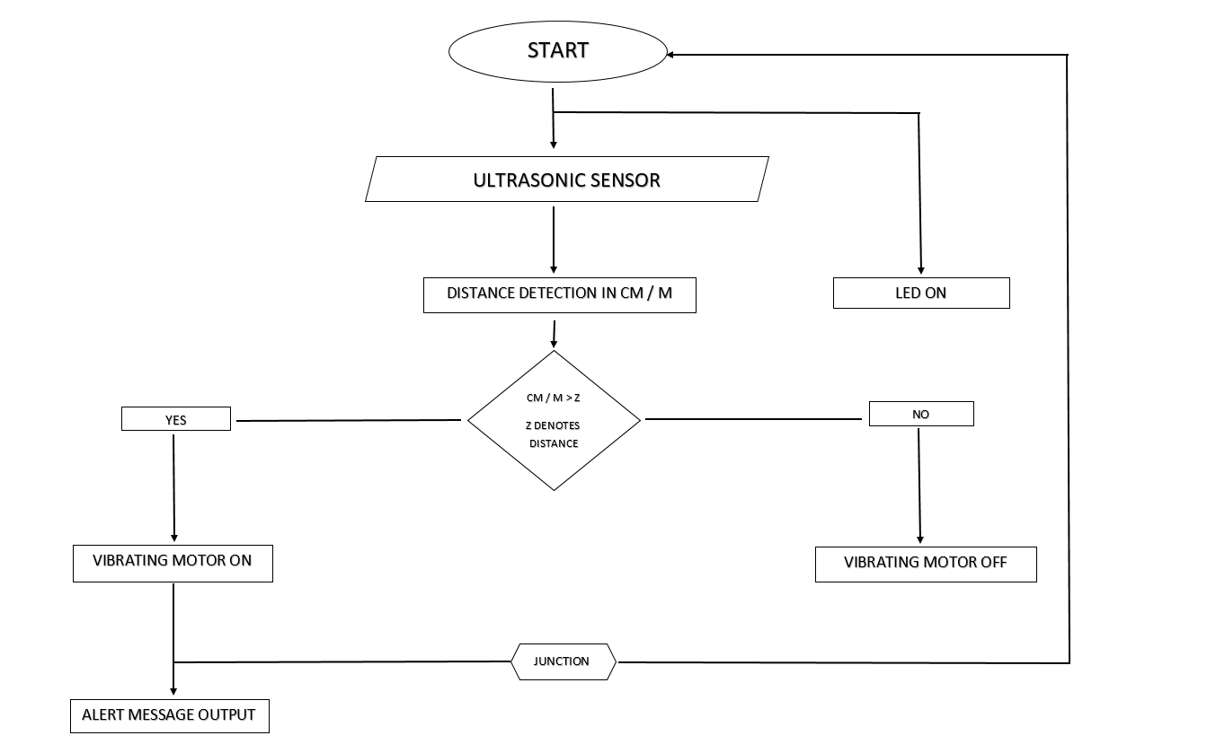
Entity relationship diagram of system

Slide 11
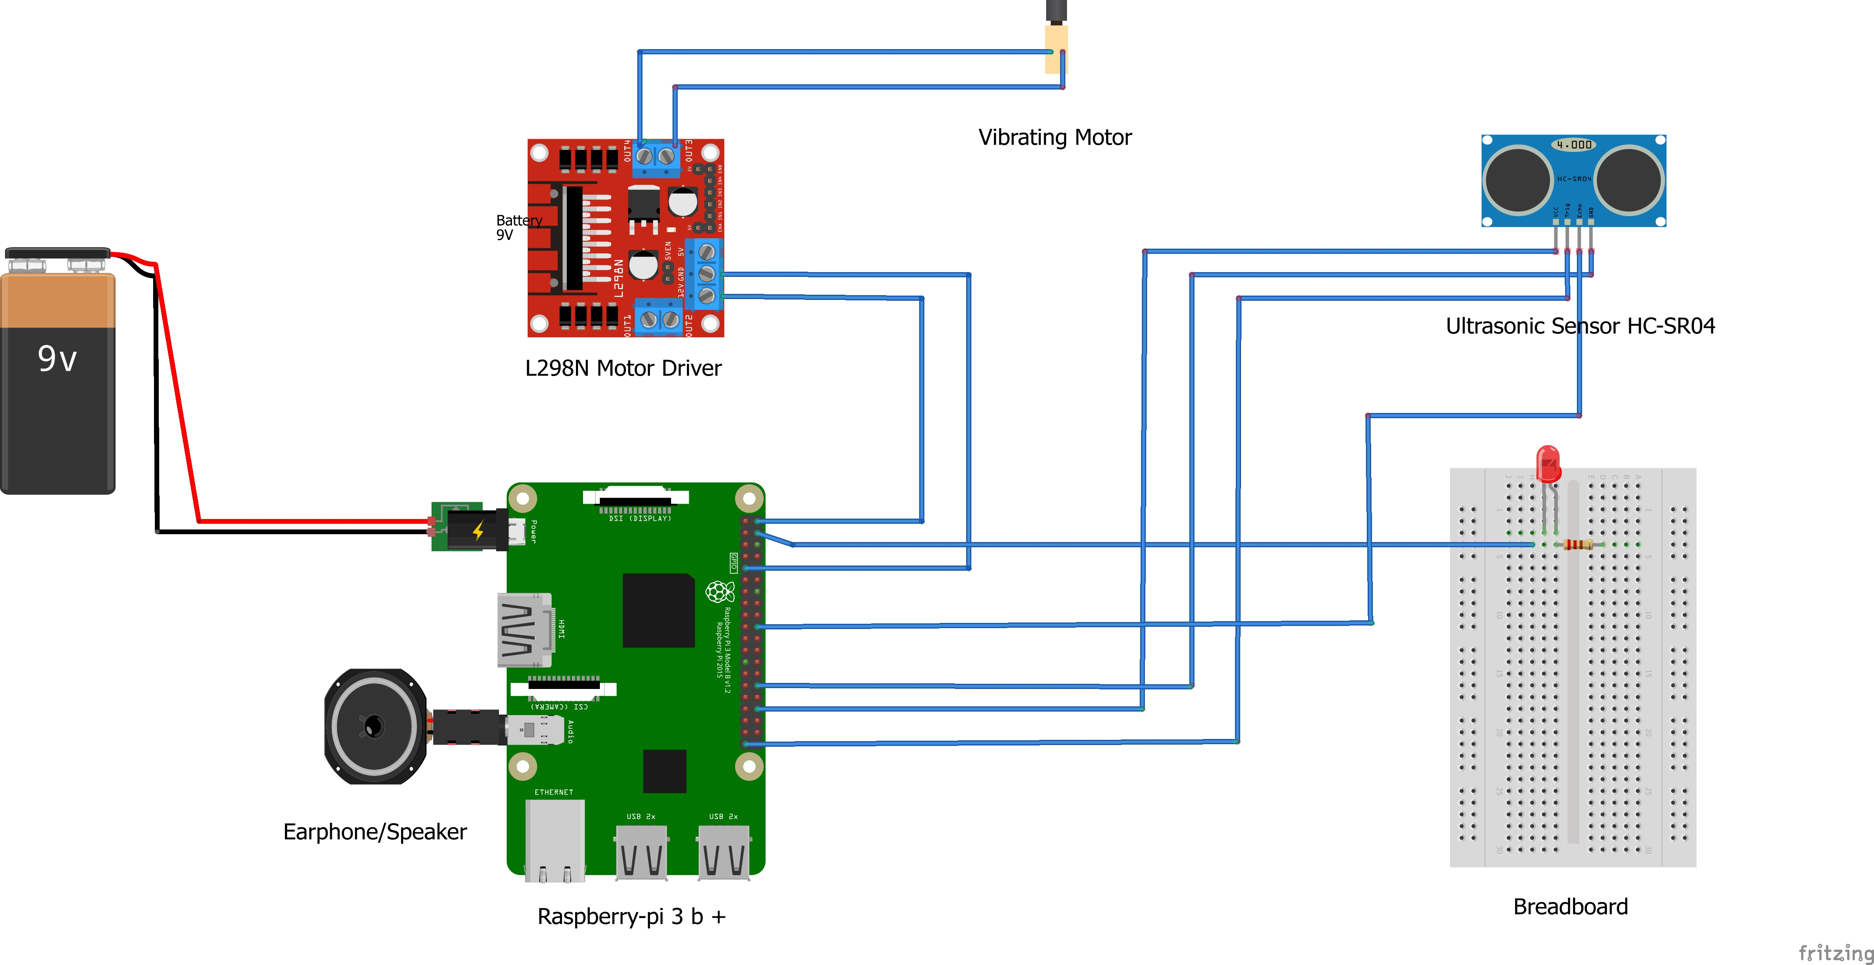
Circuit Diagram of system using fritzing

Slide 12
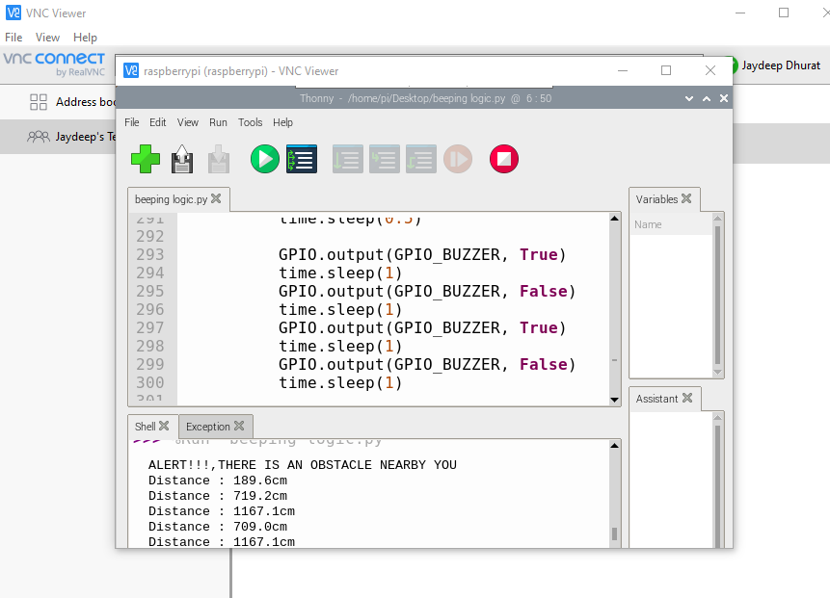
Output image of the program (real vnc viewer)

Slide 13
THANK YOU

